Slide 1
Official Statistics in Japan: Anonymized Microdata Available to Researchers
9. Jan. 2020
Dr. KIyomi Shirakawa
Hitotsubashi University
National Statistics Center
Multigenerational households in East Asia

Slide 2
Agenda
Introduction
Release of microdata files for public use
Provision of custom-made tabulation service
Provision of anonymized microdata
Monthly Magazine of ‘Statistics’ and ‘Significance’
Support for the National Institute of Statistics of Cambodia

Slide 3

[Refer] Overview of the National Statistics Center (NSTAC)
A Specialist Agency Supporting Official Statistics System
Statistics Users/
Survey Respondents
International Organizations/
Foreign Governments
■ Providing unified official statistics services
■ Providing online survey usage environments
■ Providing technical assistance
■ Participating in international conferences
National
Statistics Center
Other Ministries/
Local Governments
Academia
■ Support for compiling statistics
■ Providing basic services
■ Participating in and publicizing findings at
academic meetings
■ Cooperating with universities and research institutes
Statistics Bureau
Director –General for Policy Planning (Statistical Standards)
Statistical Research and Training Institute
Ministry of Internal Affairs and Communications

Slide 4
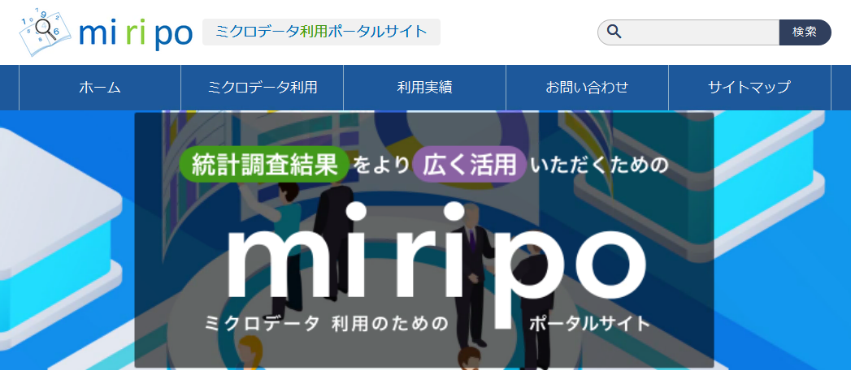
Portal Site of Secondary Use in Official Statistics
in Japanese
https://www.e-stat.go.jp/microdata/
Important: All information is in Japanese.
Notes:
さて、今年の５月１日より、miripoと称する統計データの二次的利用のポータルサイトが開設されております。こちらには、ミクロデータの利用に関する制度の概要や具体的な手続き方法、各府省の利用可能なデータ、ミクロデータの利用実績等が公開されております。
また、オンサイト利用受付相談窓口では、統計データの二次的利用についてメールでの相談を受け付けております。

Slide 5








Relationship between NSTACS and Hitotsubashi University
Conceptual Diagram of on-site use utilizing remote access
Decides on permission for application for use and taking data
On-site use of statistical microdata
National government offices and ministries
(survey conductors, such as SBJ)
Service counter
Formality check of application for use, and formality examination of taking data
Management of the data and system, etc.
Registration for the questionnaire information.
Entrusts necessary related business, such as service counter, to NSTAC.
Dedicated servers
On-site facilities
On-site facilities
SINET
(Uses the VPN service)
National
Statistics Center
Virtual PCs
Administrator
Operates virtual PCs
by remote control
(Central-data-management facilities)
Hitotsubashi University
Users
Displays the tabulated/analysis results.
(Using memory equipment, such as a USB memory stick, is prohibited and it cannot be used.)
Users
Monitoring camera
↓
On-site facilities
Formality examination is conducted when taking data
On-site facilities

Slide 6
Agenda
Introduction
Release of microdata files for public use
Provision of custom-made tabulation service
Provision of anonymized microdata
Monthly Magazine of ‘Statistics’ and ‘Significance’
Support for the National Institute of Statistics of Cambodia

Slide 7





Release of microdata files for public use
NSTAC creates a Japanese version of public use microdata files and provides them free of charge.
They are not questionnaire information (microdata) itself, but simulative microdata which were randomly generated from the estimated correlation structure of the tabulated results.
They can be used freely as data for preliminary study as part of data science in statistics education or business without entailing difficulties related to the confidentiality of individual household information.
Users must recognize that the results of these microdata analyses are not regarded as results from the corresponding real microdata.
Raw data
Learning of statistical methods
Level of usage require-
ment
Anonymized data
Collaboration with the Data Science Online Course
Public use
Microdata
Demonstration of statistical analysis software
Range of users
Contributions to international academic institutions

Slide 8
Agenda
Introduction
Release of microdata files for public use
Provision of custom-made tabulation service
Provision of anonymized microdata
Monthly Magazine of ‘Statistics’ and ‘Significance’
Support for the National Institute of Statistics of Cambodia

Slide 9
Provision of custom-made tabulation service
The framework of a statistics production service called custom-made tabulation
According to the Statistics Act of Japan, the framework of a statistics production service called custom-made tabulation, which tabulates statistics using questionnaire information in response to the requests of general users has been established.
Custom-made tabulation is limited to being used by scientific research organizations, such as universities, and some private enterprises.
NSTAC carries out custom-made tabulation since 2009.
Public benefit (contributing to the development of scientific research or higher education)
Fee

Slide 10
List of surveys NSTAC conducting custom-made tabulation
Ministries and Agencies | Surveys
Cabinet Office, Government Of Japan | Consumer Confidence Survey
 | Annual Survey of Corporate Behaviors
Ministry of Internal Affairs and Communications | Population Census
 | Housing and Land Survey
 | Family Income and Expenditure Survey
 | Survey of Household Economy
 | National Survey of Family Income and Expenditure
 | Labour Force Survey
 | Employment Status Survey
 | Survey on Time Use and Leisure Activities
 | Economic Census for Business Frame
Ministry of Education, Culture, Sports, Science and Technology | School Basic Survey
Ministry of Health, Labour and Welfare | Basic Survey on Wage Structure
Ministry of Land, Infrastructure, Transport and Tourism | Building Starts

Slide 11
Data usage process
e-stat
Find the result table
Find survey items
Can be used for aggregation
Cost
Estimate the total amount
Aggregate

Slide 12
Agenda
Introduction
Release of microdata files for public use
Provision of custom-made tabulation service
Provision of anonymized microdata
Monthly Magazine of ‘Statistics’ and ‘Significance’
Support for the National Institute of Statistics of Cambodia

Slide 13
Agenda
Provision of anonymized microdata
Original data
Anonymized microdata
Name | Age | Gender
Ramsha | 30 | Female
Yadu | 24 | Female
Salima | 28 | Female
Sunny | 27 | Male
Joan | 24 | Female
Bahuksana | 23 | Male
Rambha | 19 | Male
Kishor | 29 | Male
Johnson | 17 | Male
John | 19 | Male
Name | Age | Gender
* | 20 < Age ≤ 30 | Female
* | 20 < Age ≤ 30 | Female
* | 20 < Age ≤ 30 | Female
* | 20 < Age ≤ 30 | Male
* | 20 < Age ≤ 30 | Female
* | 20 < Age ≤ 30 | Male
* | Age ≤ 20 | Male
* | 20 < Age ≤ 30 | Male
* | Age ≤ 20 | Male
* | Age ≤ 20 | Male
Delete identifier
Main Techniques
Resampling, Recoding, rounding, Suppression, Perturbation, etc.
13

Slide 14
Anonymized Microdata in Japan
Ministry | Name of surveys
Ministry of Internal Affairs and Communications | Population census
 | Housing and land Survey
 | Employment Status Survey
 | Survey on Time Use and leisure Activities | Questionnaire A
 |  | Questionnaire B
 | National Survey of Family Income and Expenditure
 | Labour Force Survey
Ministry of Health, Labor and Welfare | Comprehensive Survey of Living Conditions | Anonymous data A （Household, Health）
 |  | Anonymous data B （Household, Health, Income, Saving）

Slide 15
Effective use of anonymized microdata
Anonymized microdata
Custom-made tabulation
On-Site
Facility
Advantages:
Detailed aggregation is possible
Most recent survey data
Disadvantages:
Advanced aggregation skills
Location restrictions
Advantages:
No aggregation skills required
Most recent survey data
Disadvantages:
Expensive
Aggregation takes time

Slide 16
Agenda
Introduction
Release of microdata files for public use
Provision of custom-made tabulation service
Provision of anonymized microdata
Monthly Magazine of ‘Statistics’ and ‘Significance’
Support for the National Institute of Statistics of Cambodia

Slide 17
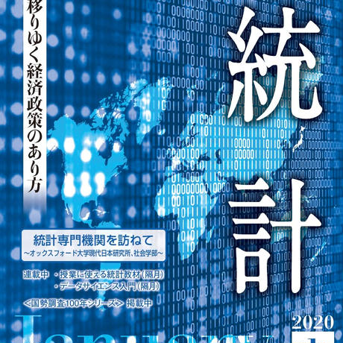
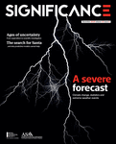
Monthly magazine‘Statistics’ and ‘Significance’
The front cover of magazines
Japan Statistical Association
The Royal Statistical Society (RSS) and
the American Statistical Association (ASA)
Permission to publish Japanese articles

Slide 18

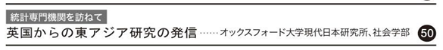
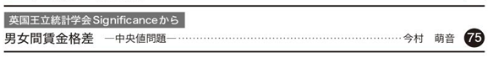
Contents of the magazine
Statistics
Visiting the Oxford University
The Nissan Institute of Japanese Studies and the Department of Sociology
Translation of Article in the magazine 'Significance'
https://rss.onlinelibrary.wiley.com/loi/17409713

Slide 19
Contents of the magazine
 | Title |  | Title
January 2020 | 男女間賃金格差―中央値問題 | August 2019 | “Gender pay gaps A median-sized problem”
December 2019 | 麻薬の使用は恵まれない若い人々がホームレスになる要因となるのか？ | June 2019 | “Does drug use lead to homelessness for young, disadvantaged people?”
November 2019 | タイタニック号の悲劇の視覚化 | February 2019 | “Visualising the Titanic disaster”
October 2019 | 分散の世紀 | August 2018 | A century of Sevariance
September 2019 | ランシス・ゴルトンの負の遺産 | June 2019 | The troubling legacy of Francis Galton
August 2019 | ゆるぎある「お名前ランキング」―超母集団モデルによる順位の不確実性推定 | June 2017 | Rank uncertainty: Why the "most popular" baby names might not be the most popular?”
Statistics
Selection criteria of article
Translator chooses and explains the article
Within 6 pages

Slide 20
Roles of Hitotsubashi University
Support for secondary use of Japanese statistical surveys
Support for anonymization in other fields
Joint research with overseas research institutions
Comparison with micro data of other countries

Slide 21
Agenda
Introduction
Release of microdata files for public use
Provision of custom-made tabulation service
Provision of anonymized microdata
Monthly Magazine of ‘Statistics’ and ‘Significance’
Support for the National Institute of Statistics of Cambodia

Slide 22
Construction of Cambodian Official Statistics Database in Hitotsubashi University and Analysis using those Data
Data analysis for improving
the quality of Cambodian statistics
Hitotsubashi University SHIRAKAWA kiyomi

Slide 23


Purpose of the lecture
Connection between Cambodia and Japan
It's important :
Statistical survey accuracy
Aggregation accuracy
Revitalizing the region
Therefore, data analysis is required
Part1: Creating some documents
Part2: Data analysis

Slide 24
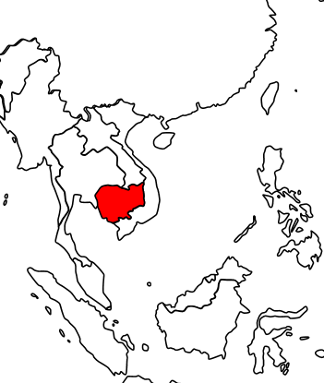
Introduction
About Cambodia
Border with Vietnam, Laos and Thailand
Total Area：181,035 km² (Half of Japan)
Population：15.6 million
（From CSES2016(estimated value)）
The civil war has continued since 1970.
A peace agreement was reached in the 1991 Paris agreement.
After peace, domestic reconstruction has progressed and economic growth has been achieved。
・1999 ASEAN joined
・2004 WTO joined

Slide 25
Introduction
About provision of Cambodian micro statistic database
Hitotsubashi University Institute of Economic Research(IER) received 15 micro data sets of 9 statistical surveys from the National Institute of Statistics of Cambodia(NIS) as part of the “Constructing Data Infrastructure for the Humanities and Social Sciences” project.
A collaborative laboratory in the IER established a Cambodia Socio-Economic Survey (CSES) database.
The above database can be used by applying for usage and obtaining approval from the Cambodian government.
The database can be used in the on-site facility in the laboratory (environment blocked from external network)
The IER conducts a predetermined review on the applicant for the results of the aggregation and analysis. The standards for examination are based on “Explanation and examples of standard check contents regarding the provision of analysis results, etc. in on-site use” of “National Statistics Center(NSTAC)”.

Slide 26
Lecture on R for NIS, Cambodia
We provided a lecture on R during 24-25 Dec, 2018
How to install
Data structure in R
How to calculate
How to create graphs
How to tabulate, etc.
Mr. Saint Lundy

Slide 27


Back Ground
Empirical analysis based on secondary use in official statistics
Our university has gotten some microdata from National Institute of Statistics (NIS) , Cambodia
We calculated some tables from its microdata for comparison with tables in annual report in the NIS's web-site.
NIS's web-site
Comparison
with tables
Calculate
University
Annual Report

Slide 28
Outline of Our Project
Providing some official microdata for researchers at the onsite facility.
Available microdata
Japan
Cambodia
It's important :
Empirical analysis based on the secondary use in official statistics
Reliability, Confidentiality and Quality Control of microdata in official statistics

Slide 29
[Refer]Available microdata in Cambodia
Cambodia Socio-Economic Survey (CSES): 2004, 2007, 2009-2010,2012- 2016.
National Census of Agriculture in Cambodia (NCAC): 2013
Cambodia Inter Censal Population Survey (CIPS) : 2013
Cambodia Inter Censal Establishment Survey (CIES) : 2014
General Population Census (GPC): 2008
Economic Census of Cambodia (ECC): 2011
Nation-Wide Establishment Listing (NWEL): 2009

Slide 30

1 Target and Purpose
Target
National Institute of Statistics, Cambodia (NIS)
Purpose
This project is to store microdata of surveys and censuses that provided from NIS in Hitotsubashi university and to use those data at an onsite facility in the university.
NIS
Providing microdata
Using data at on-site facility
Technical Support
Result of data analysis

Slide 31
2 Outline of CSES in Cambodia

Slide 32
3 List of microdata in the CSES 2016
No | Name | type | No | Name | type
1 | AREAINFORMATION | A | 19 | HHFISHCULTIVATION2 | H
2 | WEIGHTHOUSEHOLDS | H | 20 | HHFISHCULTIVATION3 | H
3 | WEIGHTPERSONS | P | 21 | HHFORESTRYHUNTING1 | H
4 | HOUSEHOLDS | H | 22 | HHFORESTRYHUNTING2 | H
5 | HHMEMBERS | P | 23 | HHNONAGRICULTURE1 | H
6 | HHFOODCONSUMPTION | H | 24 | HHNONAGRICULTURE2 | H
7 | HHRECALLNONFOOD | H | 25 | HHNONAGRICULTURE3 | H
8 | HHVULNERABILITY | H | 26 | HHLIABILITIES | H
9 | PERSONEDUCATION | P | 27 | HHINCOMEOTHERSOURCE | H
10 | HHHOUSING | H | 28 | HHCONSTRUCTION | H
11 | HHLANDOWNERSHIP | H | 29 | HHDURABLEGOODS | H
12 | HHPRODUCTIONCROPS | H | 30 | PERSONMATERNALHEALTH | P
13 | HHCOSTCULTIVATIONCROPS | H | 31 | PERSONHEALTHU2 | P
14 | HHINVENTORYCROPS | H | 32 | PERSONILLNESS | P
15 | HHSALESCROPS | H | 33 | PERSONECOCURRENT | P
16 | HHLIVESTOCK1 | H | 34 | PERSONVIOLENCEA | P
17 | HHLIVESTOCK2 | H | 35 | HHOTHERINFO | H
18 | HHFISHCULTIVATION1 | H

Slide 33
4 For Secondary Use of Microdata
In addition to questionnaires,
researchers need codebook and classification
list.
Researchers want
to know
the relationship of
those files.

Slide 34
Database structure (e.g CSES2016)
About CSES
Living environment
Database by household
Agricultural income
Agriculture(rice, fruit, natural rubber,etc)
Fishery
Forestry
Etc
Household balance
CSES2016
Demographics
Database by household members
Education
Employment status
Security
The database of aggregation rate for aggregation
Health status
Database of administrative division

Slide 35
Creating Some Documents
Codebook
Residence
Urban
Rural
Geographical
domains
Phnom Penh
Other urban
Other rural
Zones
Phnom Penh Phnom Penh
Plain Kampong Cham, Kandal, Prey Veng, …
Tonle Sap Banteay Meanchey, Battambang, …
Coast Kampot, Pheah Sihanouk, …
Plateau Kampong Speu, Kratie, Mondul Kiri, …
/ Mountain

Slide 36
Verify of the Tables
comparison

Slide 37
Results of Verification
No | Chapter | Section | Table Name |  | Aggregate check result
 |  |  | Number | Title | Result | Note
1 | 2. Demographic characteristics 2.1. Population studied in the survey |  | Table 1. | Measured or estimated population by residence. In Thousands and Percent. | TRUE | ―
2 |  |  | Table 2. | Measured or estimated population by sex. Number In Thousands and Percent. | TRUE | ―
3 |  |  | Table 3. | Measured or estimated number of households by residence. In Thousands. | TRUE | ―

Slide 38
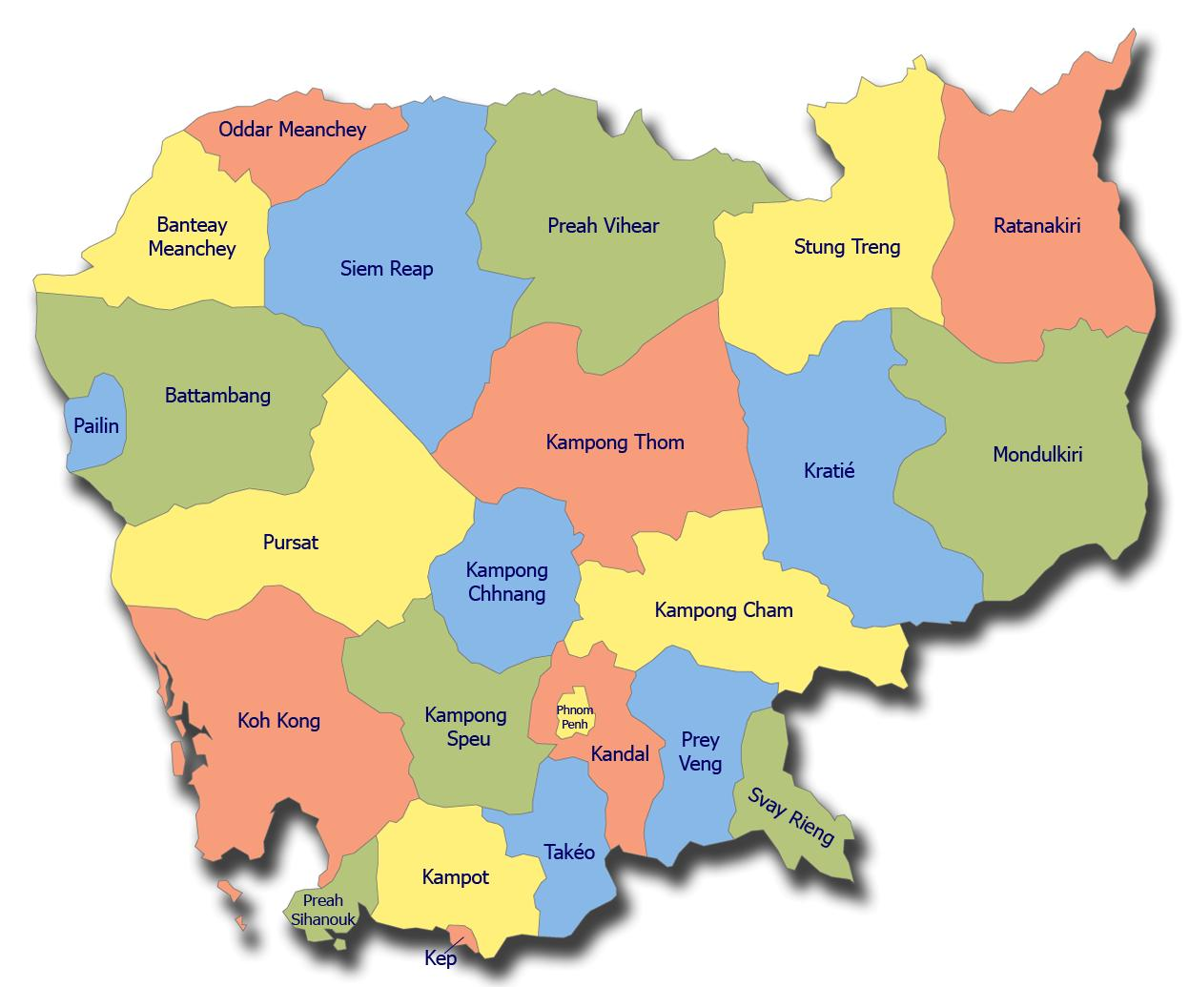
Branch Offices in Ministry of Planning
25 Branch offices
are in Cambodia
1
Visiting Branch Offices:
26-29 Dｅｃ. 2018
Kraches, Stung Treng,
Mondul Kiri and Ratana
Kiri Provinces
1-4 May. 2019
Kampot, Kep and
Preah Sihanouk Provinces
３
23-26 Dec. 2019
Prey Veng, Kandal, Takeo and
Kampong Speu Provinces
2

Slide 39
Purpose of analysis using CSES
Changes in living environment due to economic growth
What changes have occurred in the living environment of Cambodian citizens?
What are the differences in living environment between urban and rural areas?
Today, we will report an example of analysis using CSES conducted in a joint laboratory

Slide 40
Analysis method
Data
CSES2004, 2007, 2010, 2013, 2016
Summary item
Demographic information
Trends in drinking water acquisition methods
Tends in household lighting equipment and supply sources
Changes in household cooking energy supply sources
Trends in the penetration rate of household electric appliance
Trends in average income per household
 | CSES 2004 | CSES 2007 | CSES 2010 | CSES 2013 | CSES 2016
Sample | 11,993 | 3,593 | 3,592 | 3,840 | 3,829
Number of target households | 2,570,409 | 2,799,007 | 2,917,025 | 3,162,484 | 3,389,682

Slide 41
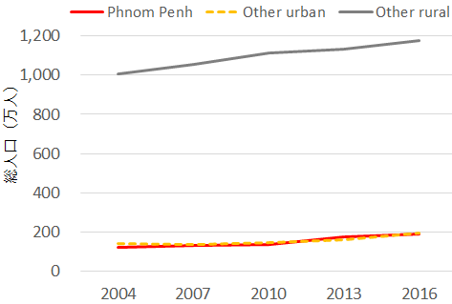
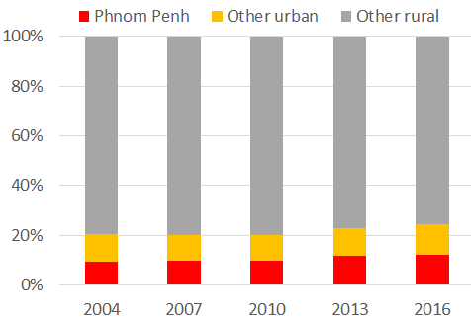
Result of analysis ：１
Changes in Cambodian population
Population transition（left） and Composition ratio（right）
The total population of Cambodia has changed from 12.65 million (2004) → 13.95 million (2010) → 15.56 million (2016)
With economic growth, the proportion of the population in the capital Phnom Penh and urban areas has increased, but 75% live in rural areas.
The composition ratio of the number of households is almost the same as the population composition ratio.
79.4
75.3
Total population（10 thousand）
11.0
12.5
9.5
12.1
Notes:
■

Slide 42
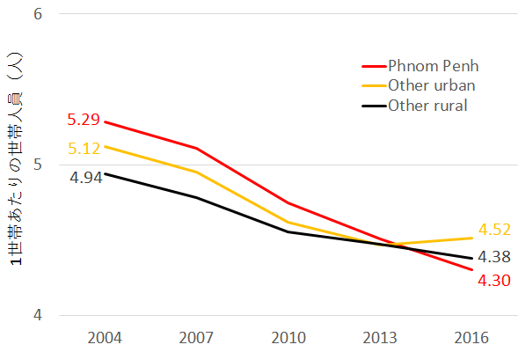
Result of analysis ：１
Changes in number of household members in Cambodia
The total number of people per household in Cambodia has changed from 4.98 (2004) → 4.57 (2010) → 4.38 (2016), and the household size is shrinking.
In the capital, Phnom Penh, the household scale has decreased more than in rural areas.
number of people per household
Notes:
■

Slide 43
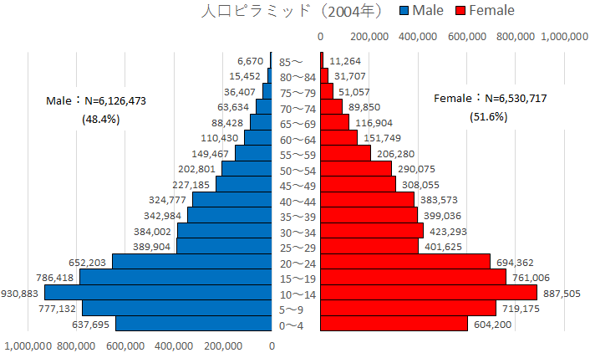
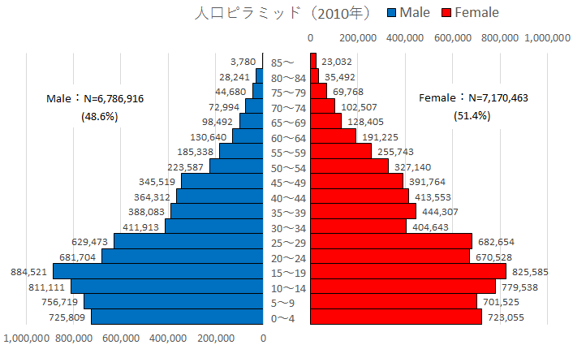
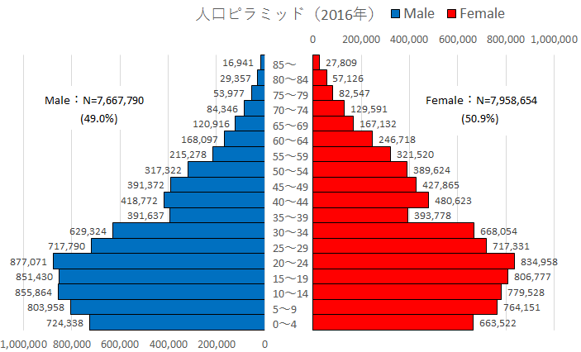
Result of analysis ：１
Cambodian population pyramid
2004
2010
2016
It is estimated from the population pyramid in 2016 that the population over the age of 35 is small due to the civil war.
The shape is closer to the pot than the Mt. Fuji found in developing countries.
Notes:
■

Slide 44
Result of analysis ：１
Cambodian population structure
Median age
Sex ratio (= 100 x male population / female population)
The change from the median age of 20 to 24 is equivalent to about 1930 (21.8) to 1955 (23.7) in Japan.
The median age in Japan in 2016 is 46.7, which is the oldest in the world.
 | Median age
2004 | 20
2007 | 22
2010 | 22
2013 | 24
2016 | 24
(From National Institute of Social Security and Population Issues, Demographic Data Collection 2019)
The sex ratio has been around 95 due to the civil war.
In Japan, the sex ratio in 2016 was 94.8, which is lower than Cambodia,
but if it is limited to those under 65, the sex ratio is 102.7.。
 | Sex Ratio
2004 | 93.8
2007 | 94.1
2010 | 94.7
2013 | 94.3
2016 | 96.3
(From Ministry of Internal Affairs and Communications Statistics Bureau population estimate)
Notes:
■

Slide 45
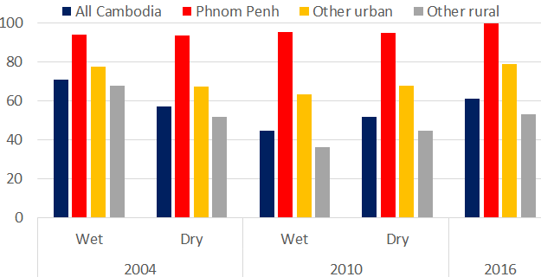
Result of analysis ：２
Trends in drinking water acquisition methods
Percentage of households that obtain drinking water through methods that are hygienic and safe (Household water supply, common faucets for each region, wells without digging, wells that are not likely to intrude outside, rainwater (Note))
In Phnom Penh, household water supply was developed as of 2004, and stable drinking water could be secured regardless of the rainy and dry seasons.
In rural areas, as of 2016, only about 50% of households have safe drinking water.
（％）
93.8
95.1
77.7
78.8
70.9
67.5
63.5
61.1
44.6
53.0
36.3
Notes:
■ CSES2016では、雨季・乾季の区別がない。
■ 雨水についての取り扱いが、CSES2004と、CSES2010,2016とでは異なる。
2004 → 貯蔵環境に関する制約がない。
2010, 2016 → 容量が少なくとも3000リットルあり、密閉されたタンクに貯蔵されており、かつ蛇口がついている場合

Slide 46
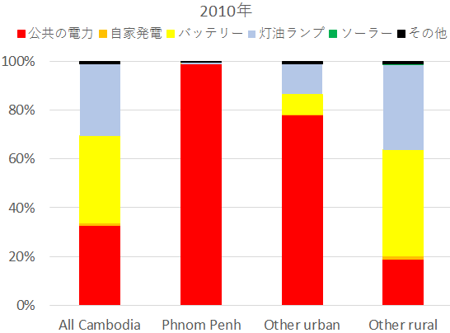
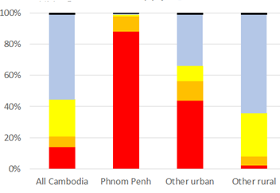
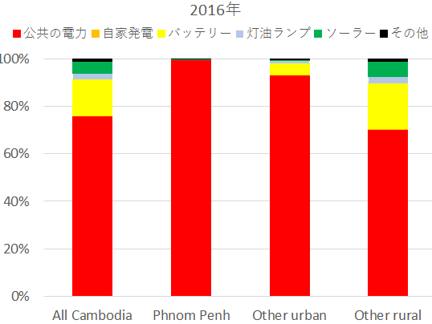
Result of analysis ：３
Trends in household lighting equipment and supply sources
2004
2010
14.2
87.9
44.0
2.2
99.0
32.4
78.1
18.8
2016
Publicly-provided electricity/City power
Generator
Battery
Kerosene lamp
Solar
Others
75.8
99.6
93.0
75.3

Slide 47
Result of analysis ：３
Trends in household lighting equipment and supply sources
2004
2010
14.2
87.9
44.0
2.2
99.0
32.4
78.1
18.8
2016
In Phnom Penh, public power was developed in 2004.
Between 2004 and 2016, urban and rural areas other than Phnom Penh have also shifted to public electricity.
In rural areas, solar power generation is increasing.
75.8
99.6
93.0
75.3

Slide 48
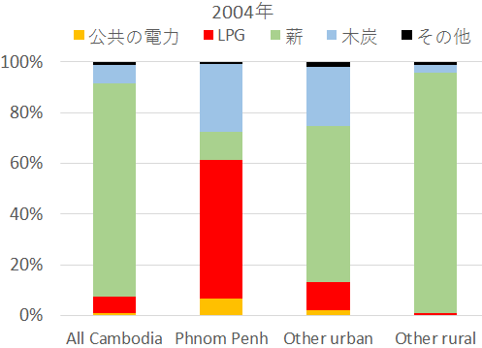
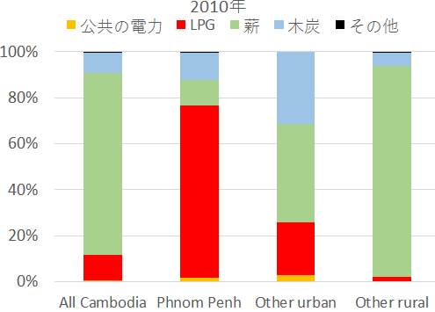
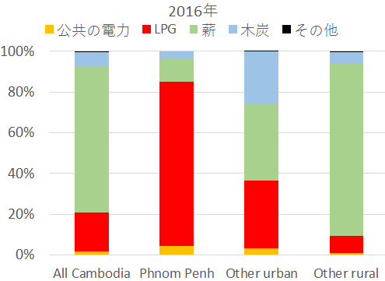
Result of analysis ：４
Changes in household cooking energy supply sources
2004
2010
84.0
61.4
94.9
79.1
43.0
91.7
54.5
11.1
74.7
23.0
6.5
11.2
2016
Publicly-provided electricity/City power
Liquefied petroleum gas (LPG)
Firewood
Charcoal
Others
71.4
37.3
85.0
19.2
80.6
33.3

Slide 49
Result of analysis ：４
Changes in household cooking energy supply sources
2004
2010
84.0
61.4
94.9
79.1
43.0
91.7
54.5
11.1
74.7
23.0
6.5
11.2
2016
Between 2004 and 2016, there was a shift from charcoal to LPG in Phnom Penh.
In urban areas, the shift from firewood to LPG is progressing.
In rural areas, many households still rely on firewood as cooking energy.
71.4
37.3
85.0
19.2
80.6
33.3

Slide 50
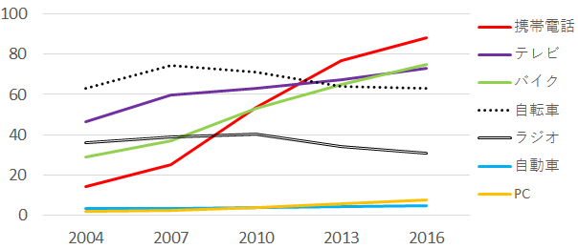
Result of analysis ：５
Trends in the penetration rate of home appliances (Cambodia)
（％）
Cell phone
Television
Motorcycle
Bicycle
Radio
Car
PC
The penetration rate of TVs and Cell phones is increasing.
As a means of transportation, bicycles and motorcycles tend to be used rather than cars.
The spread of PC has not progressed much.

Slide 51
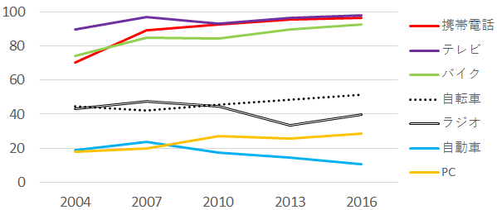
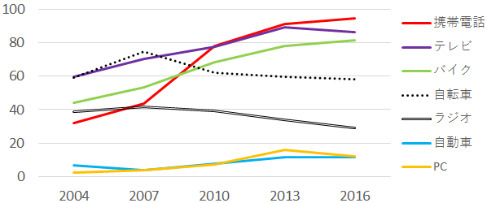
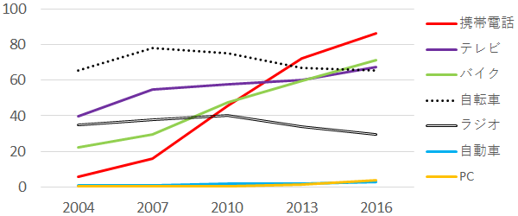
Result of analysis ：５
Trends in the penetration rate of household electric appliance（by region）
（地域別）
Phnom Penh
Since 2004, television has been prevalent in Phnom Penh.
Television and mobile phones are prevalent in almost every household.
The prevalence of automobiles is decreasing, suggesting that it is due to traffic congestion.
The penetration rate of PC is about 25%.
Other urban
The prevalence of Television and motorcycles are progressed.
Mobile phones spread rapidly between 2004 and 2010, and are now popular in almost all households.
The penetration rate of PCs is also starting to advance.
Other rural
The prevalence of Television and motorcycles are progressed.
Cell phones were rarely used as of 2004, but are now popular in over 80% of households.
Unlike urban areas, cars and PCs are not so popular.

Slide 52
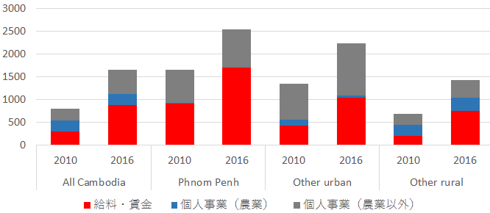
Result of analysis ：６
Trends in average monthly income per household (2010, 2016)
Unit: Riel (1 yen = about 40 Riel)
（ thousand Riel ）
2546.8
2235.7
1647.7
1649.6
1435.1
1352.9
802.4
684.7
Wage and Salary
Self-employment Income
（Agriculture）
Self-employment Income
（Non Agriculture）
Overall, income is on an upward trend.
Private business ⇒ Shift to salary income (especially urban and rural areas other than Phnom Penh)
In rural areas, income from agriculture is also increasing. (2010: 240 thousand Riel ⇒ 2016: 293 thousand Riel)

Slide 53
Summary
An example of analysis using
Today, as an analysis example using CSES, we introduced an analysis on the difference in living environment between urban and rural areas.
Cambodia is experiencing economic growth, and the living environment is changing in Phnom Penh and urban areas.
In rural areas, there are some changes in the living environment that accompanies economic growth, but there are also areas that have not changed.

Slide 54
Summary
Cambodia micro data
CSES is provided by Hitotsubashi University Economic Research Institute.
Can be used at on-site facilities within the laboratory
Analysis over time using a database of multiple years can be performed.
If you have any questions, please contact Research Centre for Information and Statistics of Social Science, Institute of Economic Research, Hitotsubashi University.
http://rcisss.ier.hit-u.ac.jp/Japanese/micro/study04.html

Slide 55
Thank you for your attention.
kshirakawa@ier.hit-u.ac.jp

